Slide 1
PETROLEUM PRICE COMPARISON in Various towns.
Fuel Price Disparities: A Comparative Analysis between Busy and Not-So-Busy Towns

Slide 2
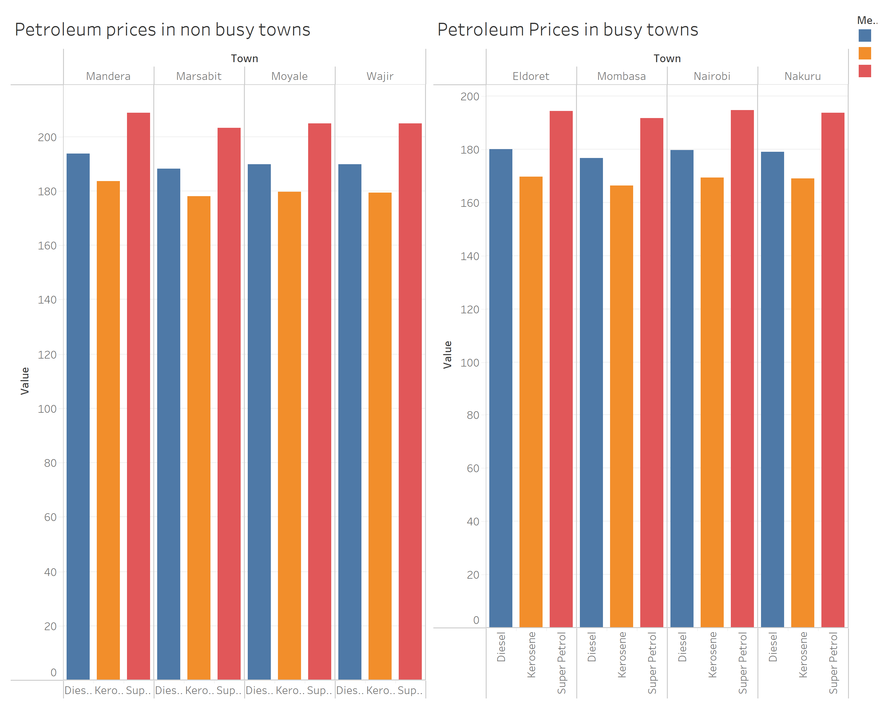
Our study aimed to examine the impact of urbanization on fuel prices in Kenya. Through data visualization, we discovered significant variations between busy urban centers and less populated towns.

Slide 3
Factors Influencing Fuel Prices
Several factors contribute to the disparity in fuel prices between bustling cities and quieter towns. These include transportation costs, demand-supply dynamics, infrastructure development, and geographical location.
In busy urban centers like Nairobi, Mombasa, Nakuru and Eldoret where demand is high and infrastructure is well-developed, fuel prices tend to be relatively stable. The presence of numerous fuel stations and competitive market conditions often mitigates sudden price fluctuations.
Conversely, in less populated areas such as Mandera, Marsabit, Moyale and Wajir, fuel prices are more susceptible to external factors. Limited infrastructure, sparse distribution networks, and higher transportation costs contribute to higher prices per liter.

Slide 4
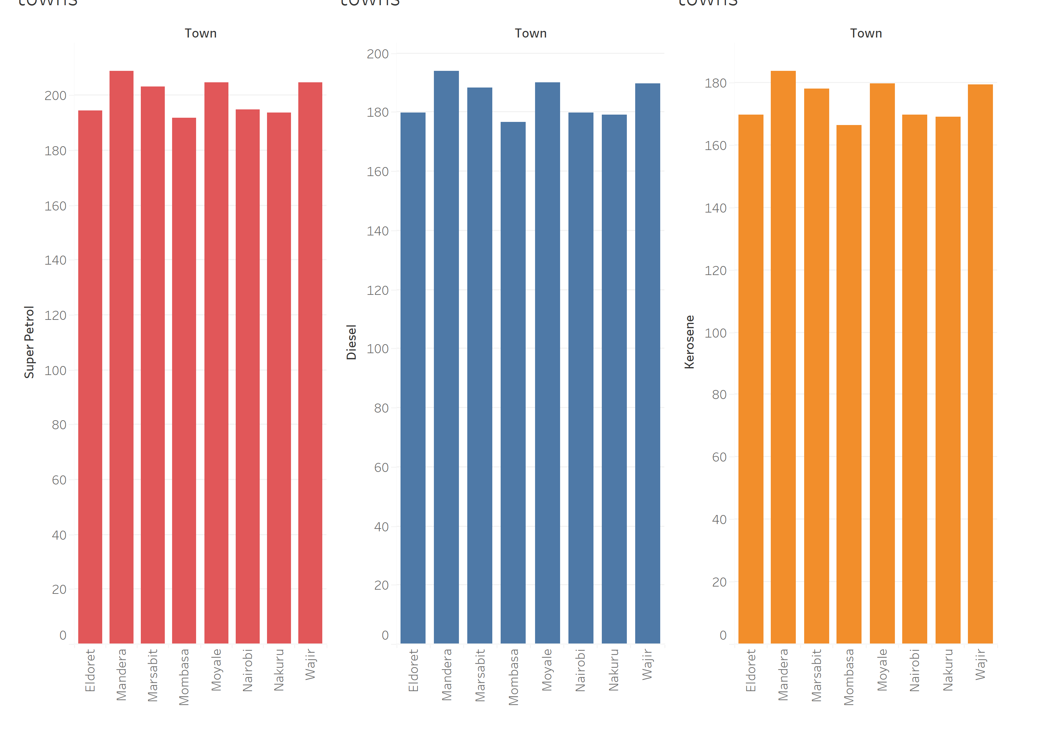
Comparison between different petroleum products.
Among all the towns, petrol being the one that is highly used recorded the highest prices per litre followed by diesel then kerosene.
Mandera being a not so busy town was the most affected town with the highest petroleum product being super petrol going for ksh.208.68 per litre, diesel ksh 193.67 and kerosene 183.49

Slide 5
Impact of Increase in Prices and Recommendations
Our data reveals that not-so-busy towns experienced a disproportionate impact from recent increases in fuel prices. Due to their vulnerability to external factors and limited competition, these towns displayed a sharper increase in prices per liter compared to their urban counterparts.
To address the disparities in fuel prices and ensure equitable access across all regions, policymakers should focus on improving infrastructure, promoting competition among suppliers, and implementing measures to mitigate the impact of price fluctuations on vulnerable communities.

Slide 6
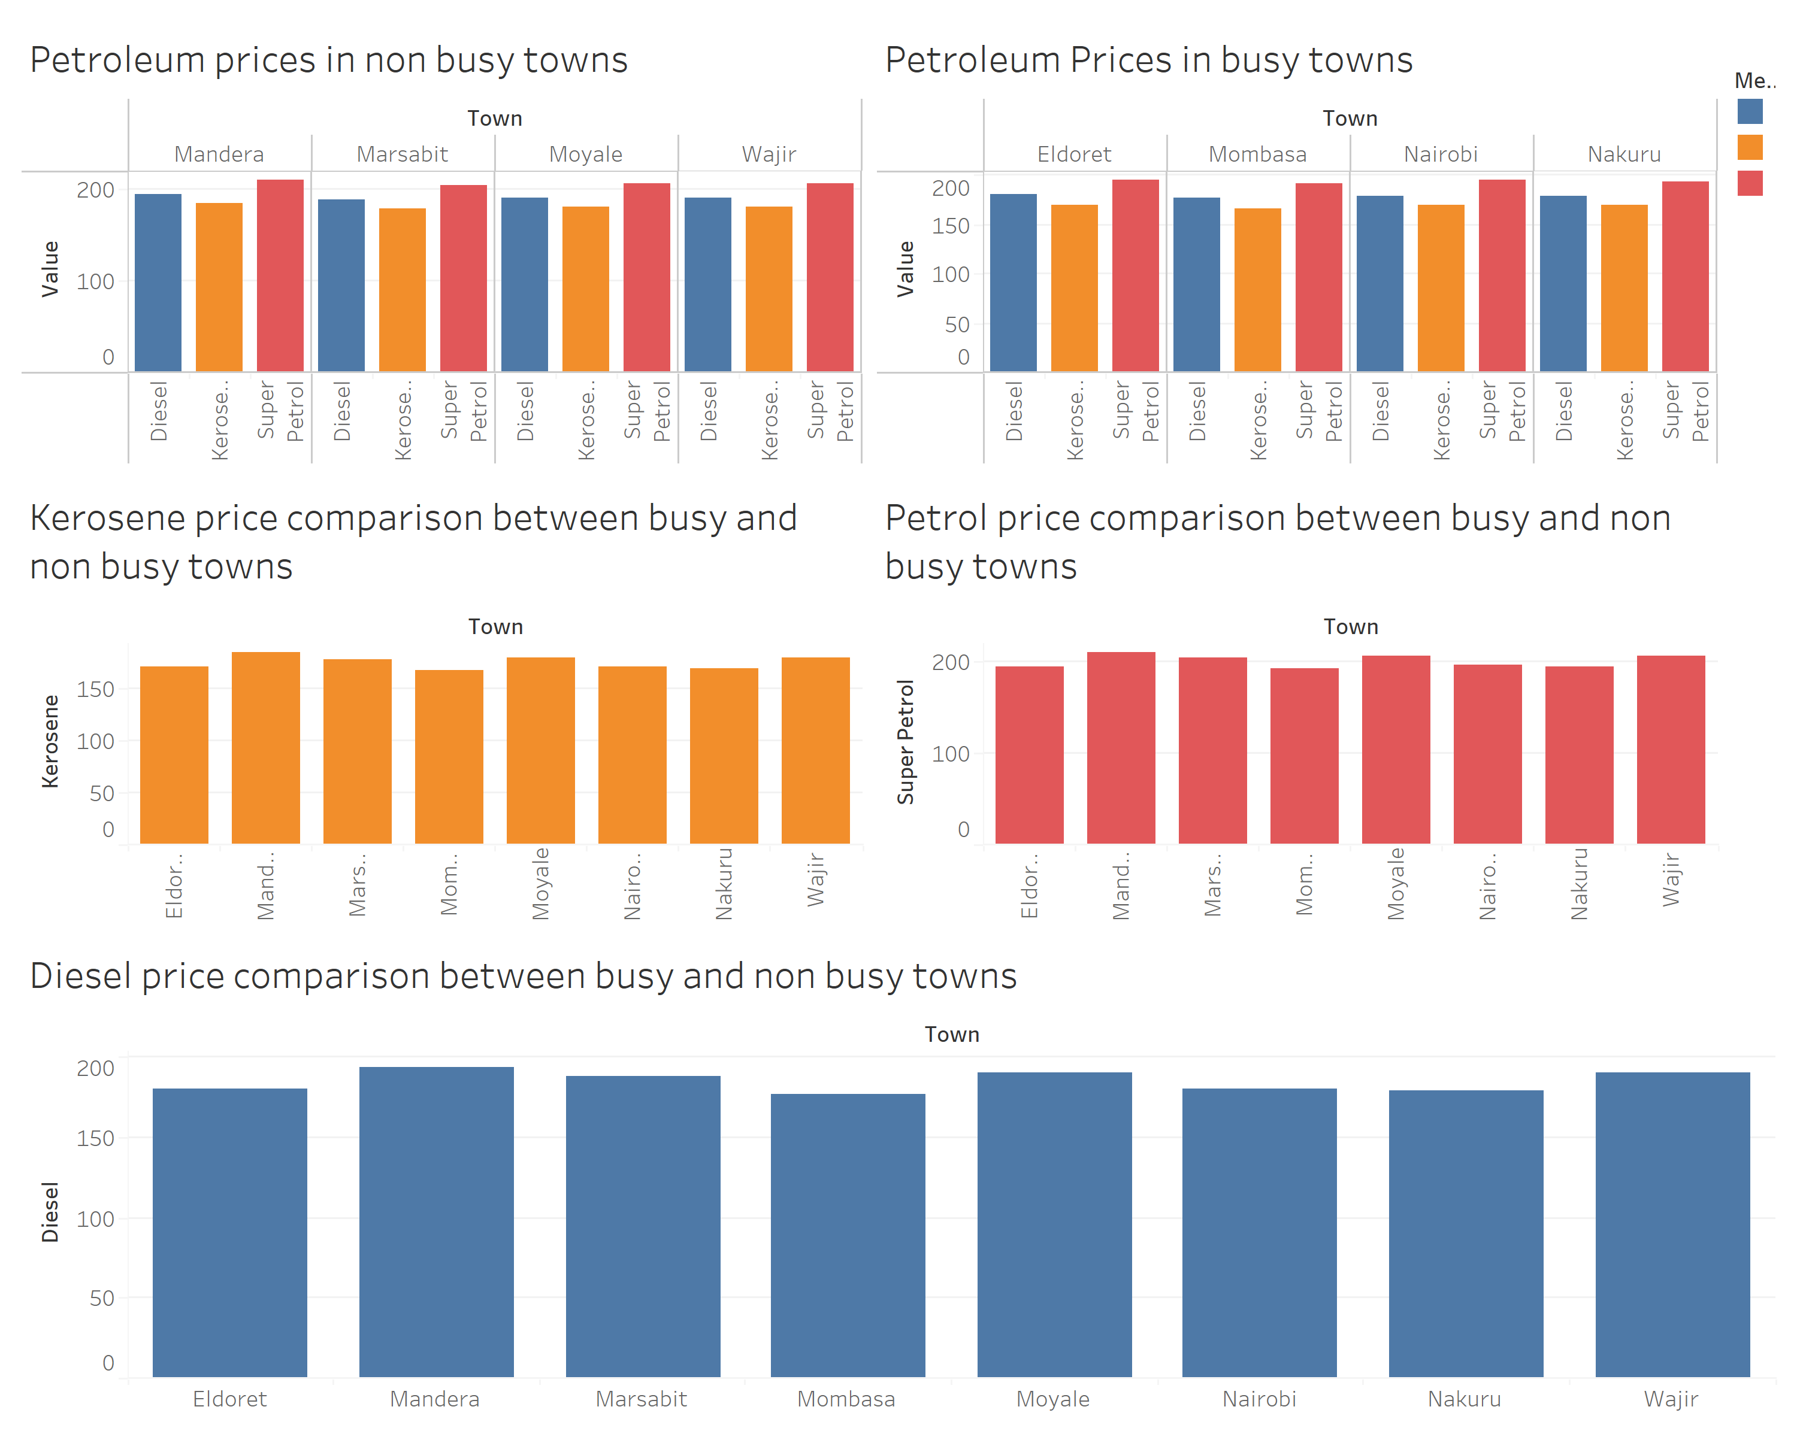
Prices between busy and non busy towns

Slide 7
Problems that can be solved by thi fuel price data .
Route Optimization: By analyzing the fuel prices in different towns over the specified period, the company can identify the most cost-effective routes for its vehicles. For example, if certain towns consistently have lower fuel prices compared to others, the company can prioritize routes that pass through these towns.
Fuel Cost Prediction: By monitoring historical fuel price trends and seasonal fluctuations, the company can predict future fuel costs in different areas. This information can be used to plan routes and schedule deliveries during periods when fuel prices are expected to be lower.

Slide 8
Conclusion
In conclusion, our analysis underscores the importance of understanding the complex interplay of factors influencing fuel prices in urban and rural areas. By addressing underlying structural issues, we can work towards creating a more inclusive and resilient energy market for all Kenyan citizens.

